Slide 1
Internet History and Privacy
Omar Guzman

Slide 2
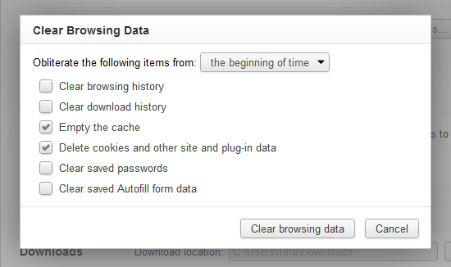
Internet History
Web browser data
Apps use
Windows 10, OSX
Phone apps for Android, and iPhone
Websites accessed

Slide 3
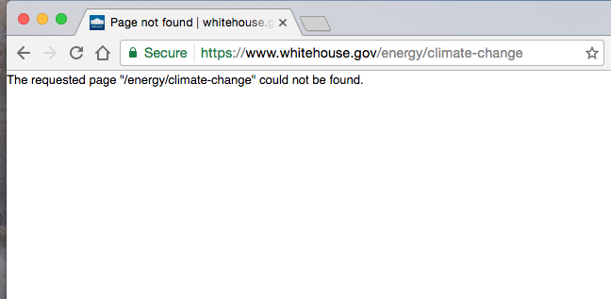
Internet History
Website accessed
Amount of times website was accessed
Reasons for internet web browser use

Slide 4

Privacy
“The state or condition of being free from being observed or disturbed by other people”

Slide 5
Internet History and Privacy
Federal Communications Commissions (FCC)
Regulates interstate and international communications
Radio
Television
Wire
Satellite
Cable
50 states, U.S. District of Columbia and U.S. territories.

Slide 6
Internet History and Privacy
FCC “rule”
Required internet service providers (ISPs) to get customers’ permission before sharing their browsing history with other companies
Protect data from hackers and inform customers of any breaches

Slide 7
Privacy
Internet Service Providers (ISP) need customer’s permission
Contact customer
Sign contract
Loyal customer

Slide 8

Senate Joint Resolution 34
The bill has been passed!

Slide 9
Internet History - Reasons for internet use
Companies can categorize customers
Legal Purposes
Illegal purposes

Slide 10
Internet History - Amount of times website was accessed
Internet history data have time stamps, GPS coordinates.
Accuracy of advertisement
Increase of sales
Customer satisfaction

Slide 11
Protect your data
Use Virtual Private Networks (VPN)s
VPNs are encrypted networks
Internet speed may be reduced

Slide 12
References
Lawler, R. (2017, March 29). US House votes to let ISPs sell your browser history. Retrieved
April 02, 2017, from https://www.engadget.com/2017/03/28/us-house-votes-to-let-isps-sell
-your-browser-history/
Schultz, M. (2017, March 29). Trump likely to sign bill allowing ISPs to sell your browsing
data. Retrieved April 02, 2017, from http://nypost.com/2017/03/28/internet-providers
-closer-to-selling-customers-private-info/
Solon, O. (2017, March 28). Your browsing history may be up for sale soon. Here's what you
need to know. Retrieved April 02, 2017, from
https://www.theguardian.com/technology/2017/mar/28/internet-service-providers-sell-
browsing-history-house-vote
Kastrenakes, J. (2017, March 29). Congress just cleared the way for internet providers to sell
your web browsing history. Retrieved April 02, 2017, from
http://www.cnbc.com/2017/03/28/congress-clears-way-for-isps-to-sell-browsing
-history.html
Newcomb, A. (2017, March 30). As Congress votes to let ISPs sell your History, movement
grows to expose theirs. Retrieved April 02, 2017, from http://www.nbcnews.com/tech/tech
-news/want-get-look-congress-internet-browsing-history-n740611

